Slide 1

Fire Alarm
KY-026
Smart Home
Project
GitHub link here

Slide 2
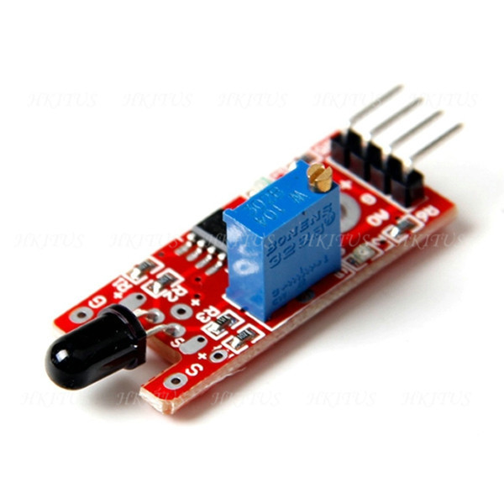
The Sensor: KY-026
Fire Sensor
Datasheet: https://tkkrlab.nl/wiki/Arduino_KY-026_Flame_sensor_module

Slide 3
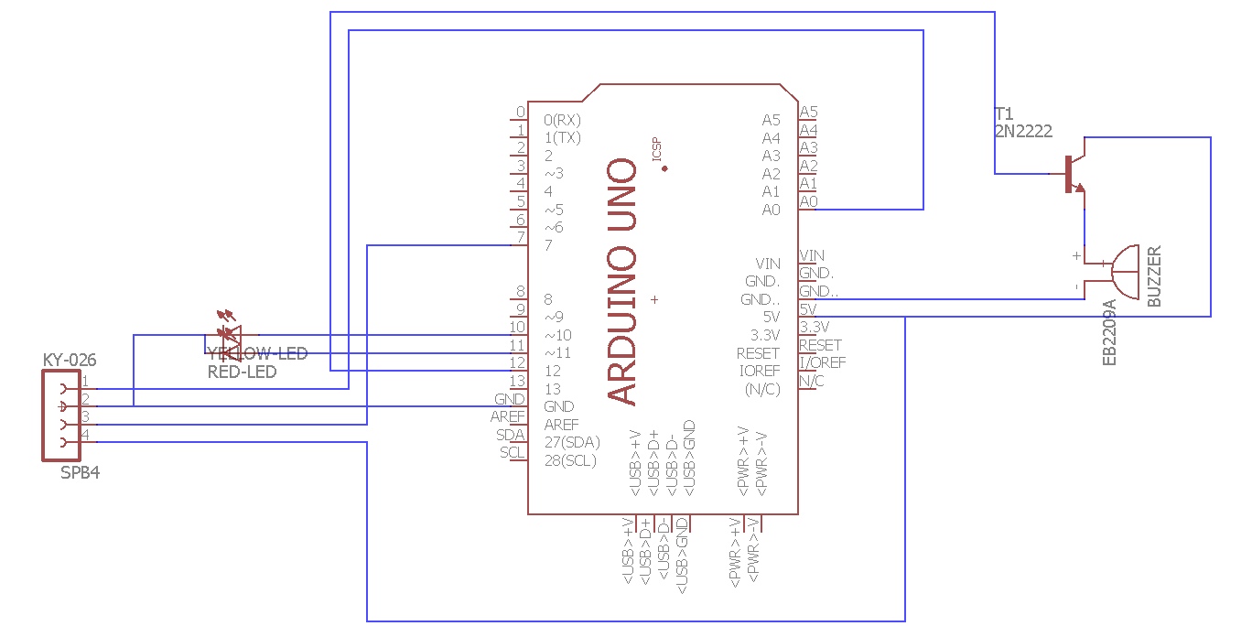
The Layout of The Design
Fire Sensor

Slide 4
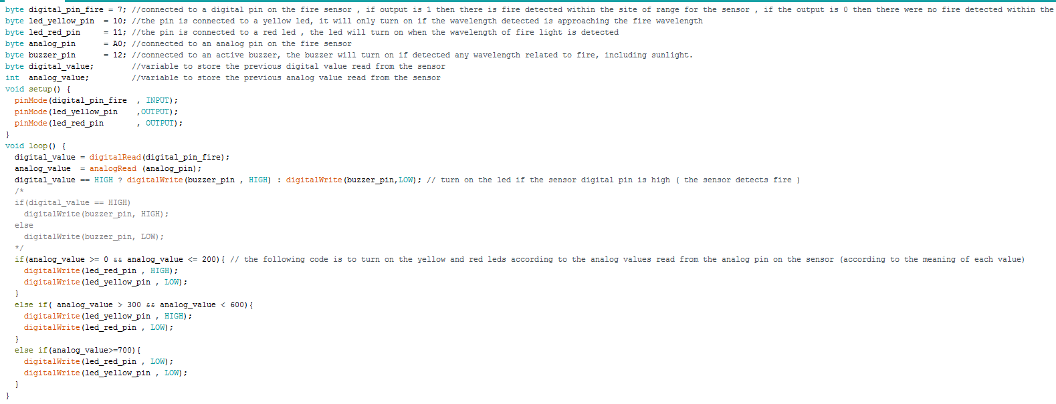
The Code:
Fire Sensor

Slide 5
source
byte digital_pin_fire = 7; //connected to a digital pin on the fire sensor , if output is 1 then there is fire detected within the site of range for the sensor , if the output is 0 then there were no fire detected within the range of sight
byte led_yellow_pin = 10; //the pin is connected to a yellow led, it will only turn on if the wavelength detected is approaching the fire wavelength
byte led_red_pin = 11; //the pin is connected to a red led , the led will turn on when the wavelength of fire light is detected
byte analog_pin = A0; //connected to an analog pin on the fire sensor
byte buzzer_pin = 12; //connected to an active buzzer, the buzzer will turn on if detected any wavelength related to fire, including sunlight.
byte digital_value; //variable to store the previous digital value read from the sensor
int analog_value; //variable to store the previous analog value read from the sensor
void setup() {
pinMode(digital_pin_fire , INPUT);
pinMode(led_yellow_pin ,OUTPUT);
pinMode(led_red_pin , OUTPUT);
}
void loop() {
digital_value = digitalRead(digital_pin_fire);
analog_value = analogRead (analog_pin);
digital_value == HIGH ? digitalWrite(buzzer_pin , HIGH) : digitalWrite(buzzer_pin,LOW); // turn on the led if the sensor digital pin is high ( the sensor detects fire )
/*
if(digital_value == HIGH)
digitalWrite(buzzer_pin, HIGH);
else
digitalWrite(buzzer_pin, LOW);
*/
if(analog_value >= 0 && analog_value <= 200){ // the following code is to turn on the yellow and red leds according to the analog values read from the analog pin on the sensor (according to the meaning of each value)
digitalWrite(led_red_pin , HIGH);
digitalWrite(led_yellow_pin , LOW);
}
else if( analog_value > 300 && analog_value < 600){
digitalWrite(led_yellow_pin , HIGH);
digitalWrite(led_red_pin , LOW);
}
else if(analog_value>=700){
digitalWrite(led_red_pin , LOW);
digitalWrite(led_yellow_pin , LOW);
}
}
Fire Sensor

Slide 6
How It Works
When the sensor detects fire, a +5V (logic 1) will be outputted on the pin D0 of the sensor.
When the microcontroller reads logic 1 on the chosen pin in the setup code, it will activate a buzzer to indicate that there is fire.
The analog pin on the sensor indicates the intensity of the fire it reads in this case, it will give certain output voltage for a certain distance where it detected the fire.
Note that this is just a preliminary usage of the sensor, the sensor’s readings will be utilized more as we progress in the Project.
Fire Sensor

